Slide 1



Creating Inclusive Spaces for Women in Tech and Media
June – July 2023 via Zoom

Slide 2
Objectives
Teach #ASKnet community new skills which help enable women empowerment and support to build networks in their communities.
Provide participants with concrete strategies and tools for creating inclusive spaces for women
Discuss best practices for maintaining women's participation in media activities and workshops
Develop practical skills and tools for implementing these best practices in their own organizations and work
Offer strategies for addressing the challenges faced by the women and organizations themselves

Slide 3

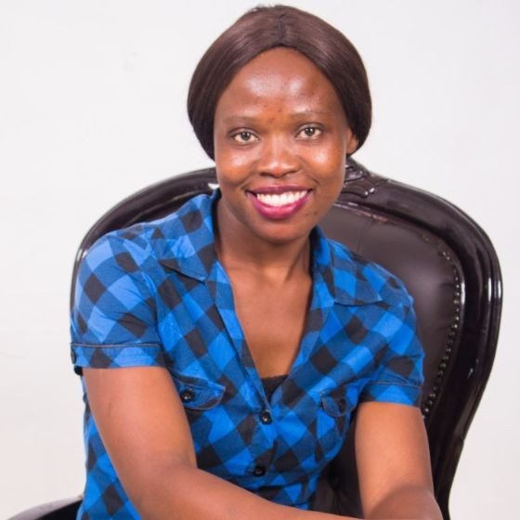
Facilitators:
Kudzai https://www.linkedin.com/in/kudzaimmubaiwa/
Soneni https://www.linkedin.com/in/soneni-mafu-55447210b/
Notes:
Topic Slide – 3 mins
Introduction Facilitators + Participants (chat) – 7 mins
Rules 3D – Discouragement, Dullness, - 5 mins
What? First came to mind in relation to your work? (chat/ open mics) – 5 mins
Why? Scale 1-10 do you think women inclusion matters? (mentimeter / chat)
Scale 1-10 how inclusive are your programs? (chat)
Wins? Struggles- idea board – 20mins
How? (Mad Hatter) – tools? – 10 mins
Q/A – Stretches and Bio Break
Inequality Triangle – 20mins
Q/A Comments
Case Study + AMA – Mercy
Homework – 2 Questions and SASA
Peer to Peer Presentations
Topic Slide – 3 mins
Introduction Facilitators + Participants (chat) – 7 mins
Rules 3D – Discouragement, Dullness, - 5 mins
What? First came to mind in relation to your work? (chat/ open mics) – 5 mins
Why? Scale 1-10 do you think women inclusion matters? (mentimeter / chat)
Scale 1-10 how inclusive are your programs? (chat)
Wins? Struggles- idea board – 20mins
How? (Mad Hatter) – tools? – 10 mins
Q/A – Stretches and Bio Break
Inequality Triangle – 20mins
Q/A Comments
Case Study + AMA – Mercy
Homework – 2 Questions and SASA
Peer to Peer Presentations
Topic Slide – 3 mins
Introduction Facilitators + Participants (chat) – 7 mins
Rules 3D – Discouragement, Dullness, - 5 mins
What? First came to mind in relation to your work? (chat/ open mics) – 5 mins
Why? Scale 1-10 do you think women inclusion matters? (mentimeter / chat)
Scale 1-10 how inclusive are your programs? (chat)
Wins? Struggles- idea board – 20mins
How? (Mad Hatter) – tools? – 10 mins
Q/A – Stretches and Bio Break
Inequality Triangle – 20mins
Q/A Comments
Case Study + AMA – Mercy
Homework – 2 Questions and SASA
Peer to Peer Presentations

Slide 4
Community Introductions + Ways of Working
Favorite Fruit!
Your Name, Your Institution, Your Country
3D – Disturbance, Discouragement, Dullness

Slide 5
Sessions
Thursday 22 June 8am GMT+2 : Introduction and Theory
Friday 23 June 9am GMT+2: Case Study and AMA + Exercise Draft
XXXXXX ? – Team Offline Exercise
XXXXXX ? – Community of Practice

Slide 6
What?
In chat: What comes to mind first when you think about this topic and your work?

Slide 7
Why?
Why does women inclusion in tech and media spaces matters? (one word, phrase) https://www.menti.com/alr4t4znhcj5
How women inclusive are your programs? https://app.sli.do/event/sUFg59gq7AuPvCdsu7FhW3
Pulse Check: https://ideaboardz.com/for/ASKnet%20Inclusive%20Spaces%20for%20Women%20in%20Tech%20and%20Media/4976181
What are your wins?
What are your struggles?

Slide 8
How?
What can/should we be doing?
What resources/tools do we need?

Slide 9

Bio Break
Stretch
Get water/coffee/tea
Bathroom break

Slide 10
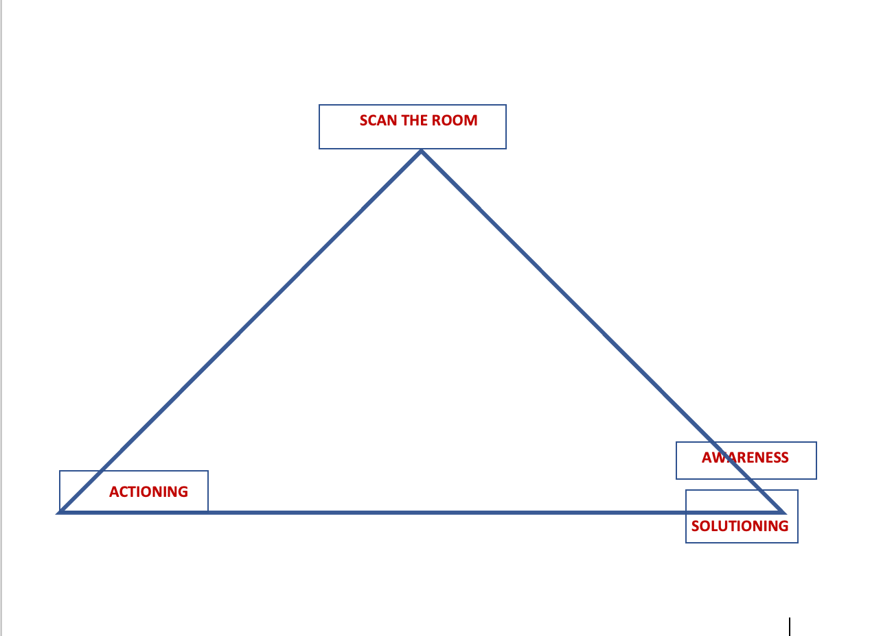
Inequality Triangle
(Attribution- Matshepo Msibi)
Scan
Awareness
Solutioning
Actioning

Slide 11
Inequality Triangle
1. Scan the the room/ to ensure representativeness. Look around to check if we are all here (this creates self-awareness).
2a. Create corporate awareness (the fact that you know that not everyone is represented does not mean that the next person is aware). You do this by asking the next person if we are all represented
2b. Come up with solutions to address gender inequality
3. Actioning- actually putting the solutions into actions.
“Finding a hundred solutions and implementing none is an exercise in futility” (Warren Buffett)
Reference: https://www.youtube.com/watch?v=yqF5C0xU-f4

Slide 12
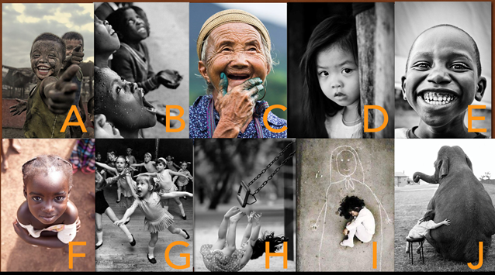
Feedback Session – Which are you?

Slide 13
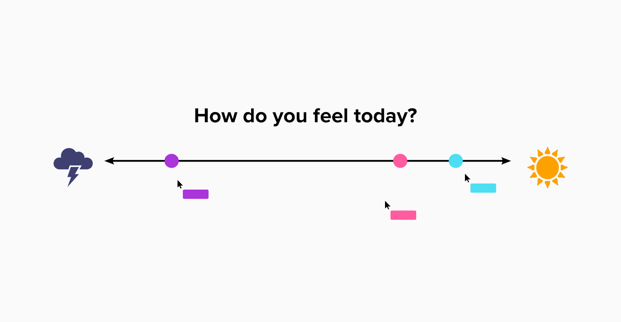
23 June - Recap Session / Pulse Check

Slide 14

Case Study – Owilla Abiro Mercy
https://www.linkedin.com/in/owilla-abiro-mercy-bb5529120/?originalSubdomain=ug

Slide 15


Ask Me Anything

Slide 16
Activity / Exercise (Offline)
In class, in 6 minutes, on paper
Before we started I did not know…….(1 minute)
Now I have learnt……………….. (1 minute)
Complete the Inequality Triangle [S.A.M.A] (4 minutes)
Take picture and submit in WhatsApp/Telegram
Offline, with team, discuss, type, email or submit for discussion at next meeting which will be on……..(lets decide now)

Slide 17


Slide 18
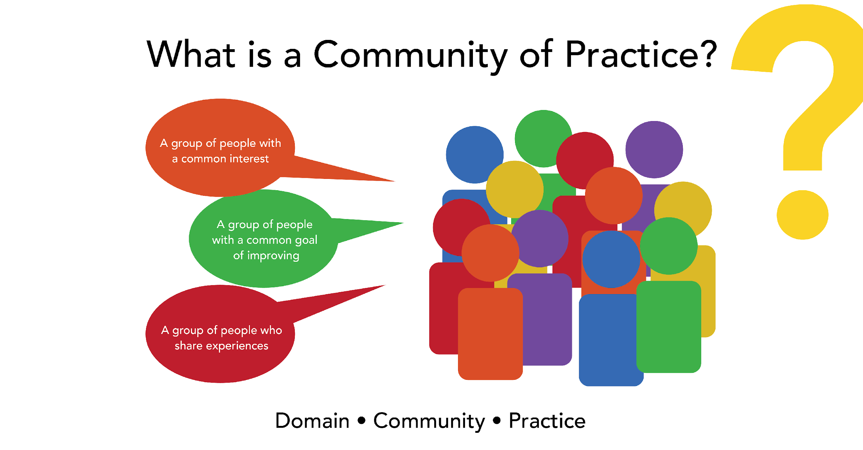
Community of Practice

Slide 19

Tool Box Elements
Individual/Institutional Brainstorming from lived experiences
Community Sharing – Case Studies and Scenarios
Collecting and collating experiences
Expert Guidance/Intervention
ToolBox Development + Additional Resources

Slide 20
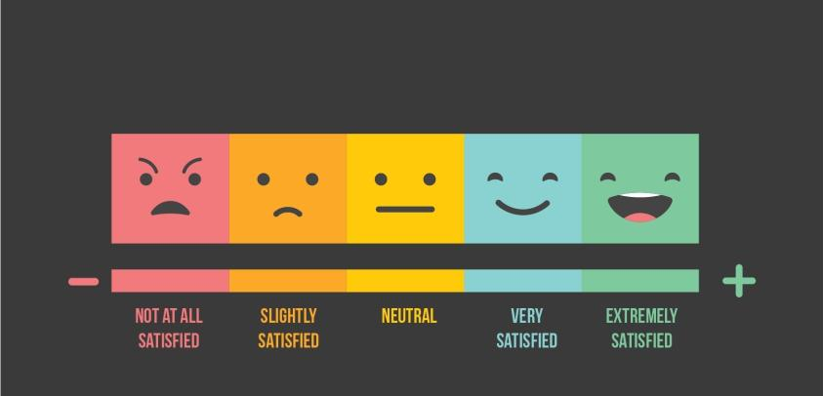
Outro

Slide 21


